Slide 1
Data logging
Dexter R. Shepherd

Slide 2
Recap
Looked at uses of microcontrollers in research
Went over examples of digital and analogue devices
Got to grips with the code

Slide 3
Contents
Why do we do data logging
Formatting data to be useful
Storage constraints and efficiency
How we can do this in circuitpython
Transfering to a PC

Slide 4
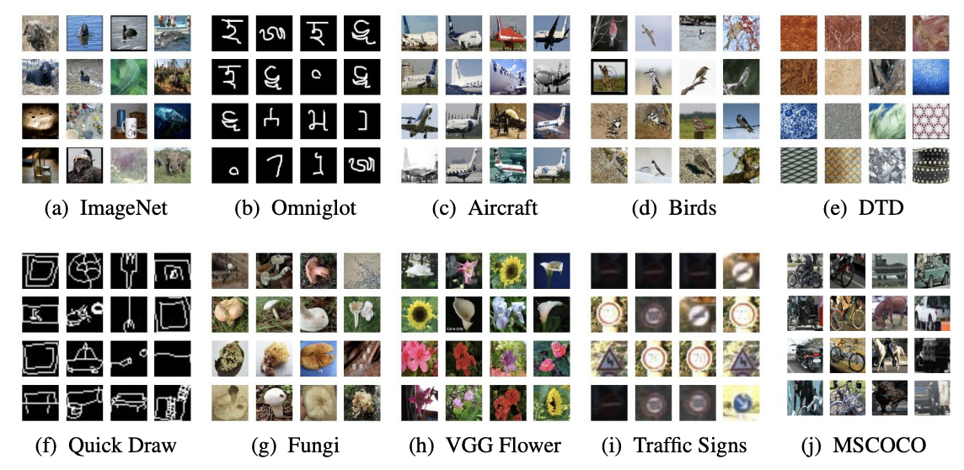
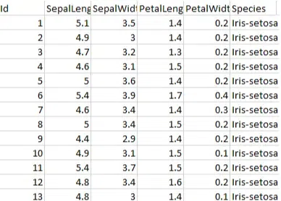
Datasets
A collection of data
Used for making models

Slide 5
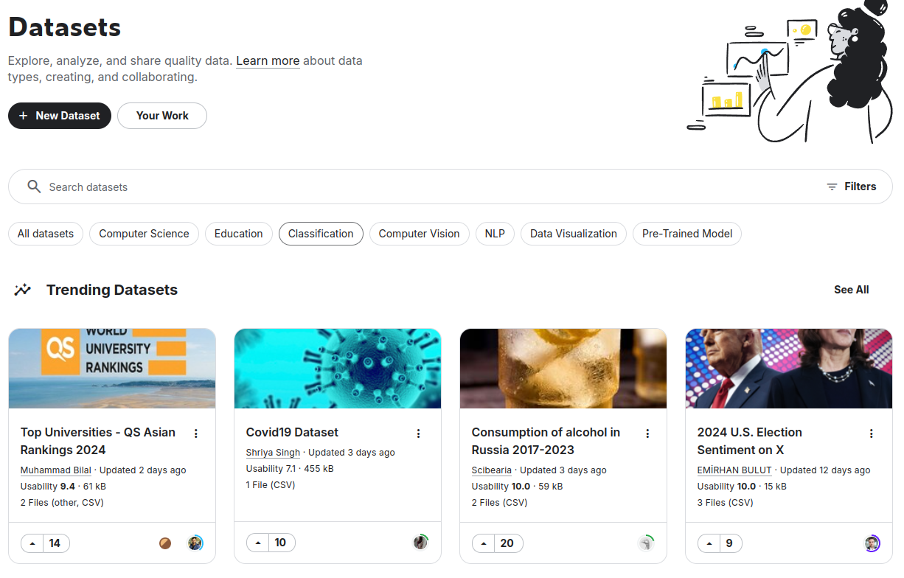
Online datasets
https://www.kaggle.com/datasets
https://huggingface.co/

Slide 6
Why make your own?
There might not be a dataset doing what you want
Your task might be very specific
The existing datasets might not be well documented

Slide 7
Formatting data
Important attributes
Easy to work with
Smaller files are better (image compression)

Slide 8
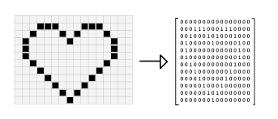
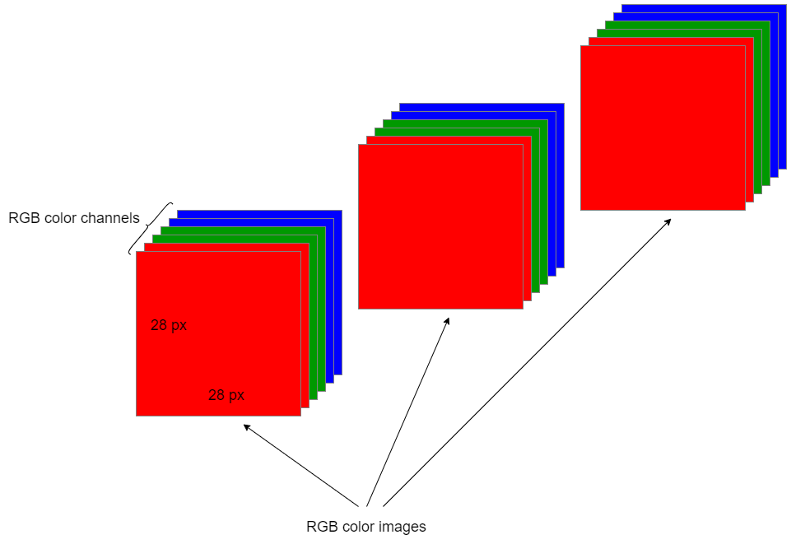
Images
Images are matrices
Pixels are represented by tuples (R,G,B) where a numeric values are an integer between 0 and 255 representing how much colour of each R G B.
A grayscale image is simply one value of 0-255
Colour image: H x W x 3
Grey scale: H x W x 1

Slide 9
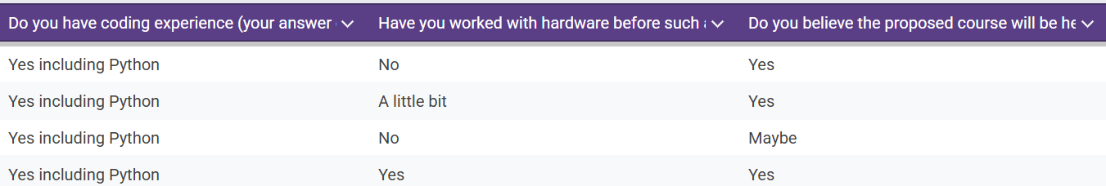
Text
Some datasets use text such as tweets or survey information. Many surveys are gathered via existing softwares such as google forms or survey monkey… this is already in csv format

Slide 10
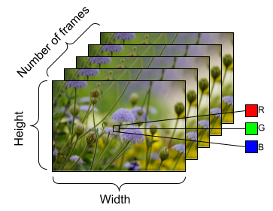
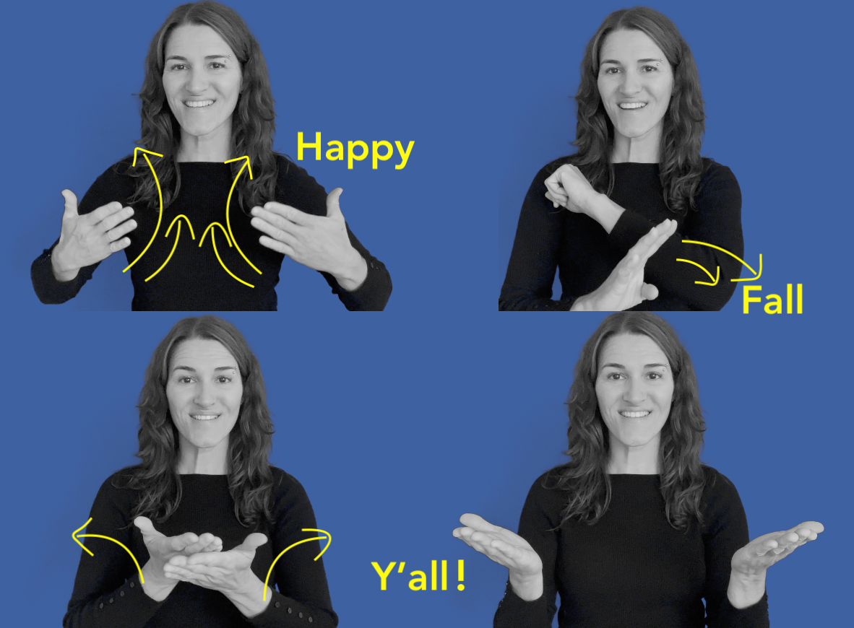
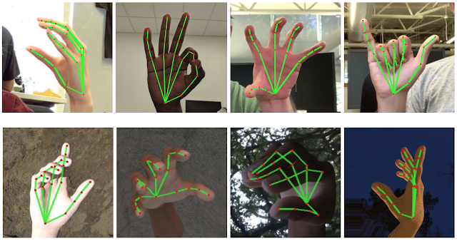
Videos

Slide 11
Compression
Saving an image as a jpeg will naturally compress it, but datasets do not always come as a folder of images (messy to code)…
If we do not compress the files will be too big
numpy.savez_compressed()
Think about the dtype
x = np.array([1, 2, 2.5])
x = x.astype(np.uint8)

Slide 12
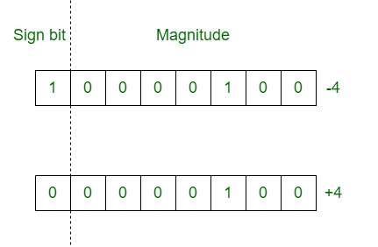
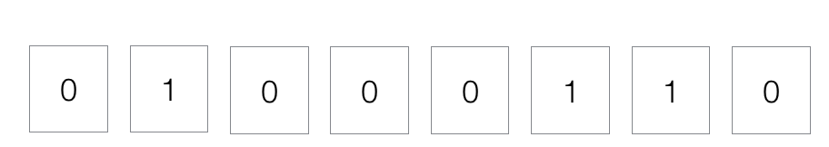
Data allocated size
For images a pixel value is between 0-255, which can be represented by an unsigned 8-bit binary value
For analogue the range can be higher or even decimal

Slide 13
What do we use for what
Data | Range required | Numpy data type
image | 0 - 255 | np.uint8 (0 - 255)
Points in a game | -50 - 50 | np.int8 (-128 - 127)
Analogue data | -3000.0 - 3000.0 | np.float16 (6.10 × 10⁻⁵ - 6.10 × 10⁴)
Survey data of selected options | 0 - 4 | np.uint8 (0-255)

Slide 14
CSV (comma separated values)
CSV or spreadsheet data is great for singular values being stored in a structured way
Example soil readings in different locations

Slide 15
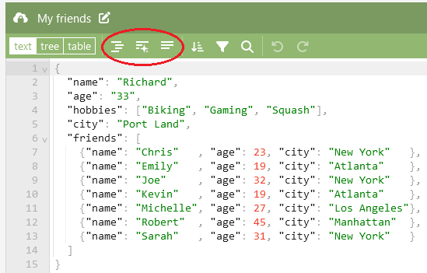
Json
A bit more structured than a table
Does this remind you of a data structure

Slide 16
What should you use?
What fits your data….

Slide 17
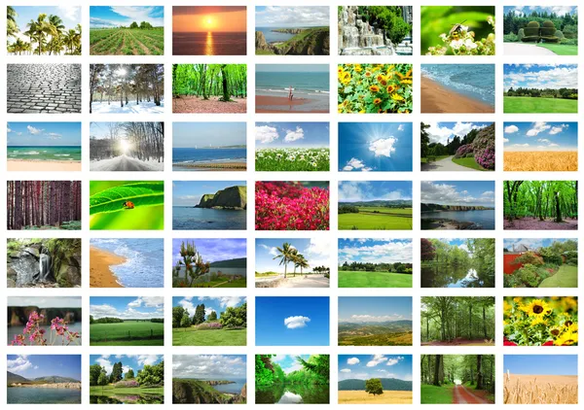
Collection of images

Slide 18
Collection of images
Compressed numpy for python, or just a folder

Slide 19
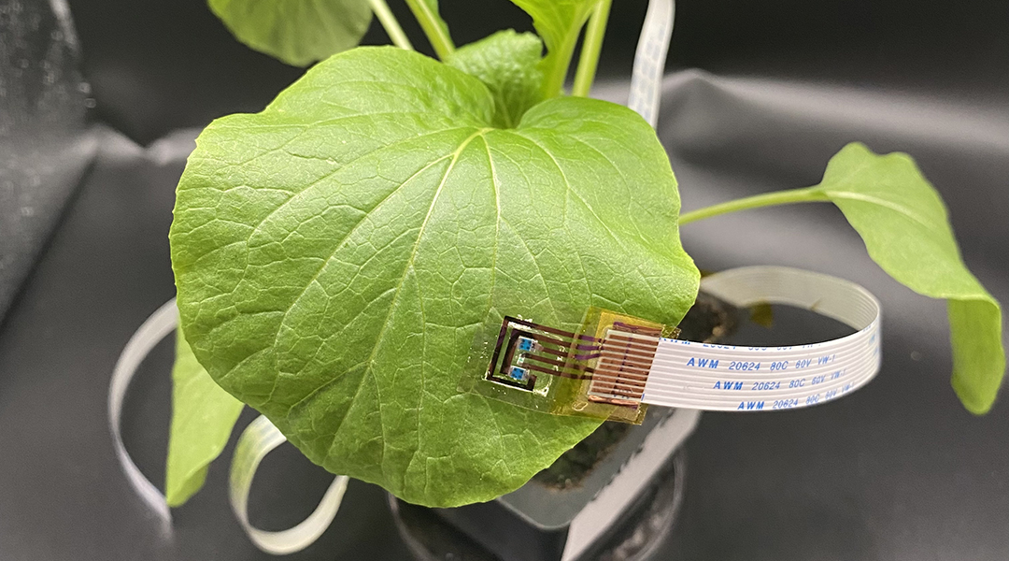
Stress readings of a plant

Slide 20
Stress readings of a plant
You could have a table (csv)
Time step | Channel 1 | Channel 2 | Channel 3
0.001 | 454 | 55 | 0
0.002 | 465 | 66 | 1
0.003 | 455 | 76 | 1

Slide 21
Stress readings of a plant
You could have a json
{name=”experiment”,
location=[-1.2222,100222],
time_Step=0.001,
readings_chanA=[1000,1000,2000,2020,2000],
readings_chanB=[1000,1000,2000,2020,2000]
}

Slide 22
Which do you pick?
Is a json or csv better?

Slide 23
Which do you pick?
JSON
Better at containing more detailed information
CSV
Less memory is used
Easier to work with from a coding point of view
Can be read by excel

Slide 24
Which do you pick?
Use JSON when you need to represent hierarchical or complex data, or when working with APIs or web applications.
Use CSV for simple tabular data, especially if you prioritize compactness and compatibility with tools like Excel.

Slide 25
Memory

Slide 26
What do we want?
Typically we want to gather as much data and metadata to avoid repeating an experiment
BUT this comes at a price

Slide 27
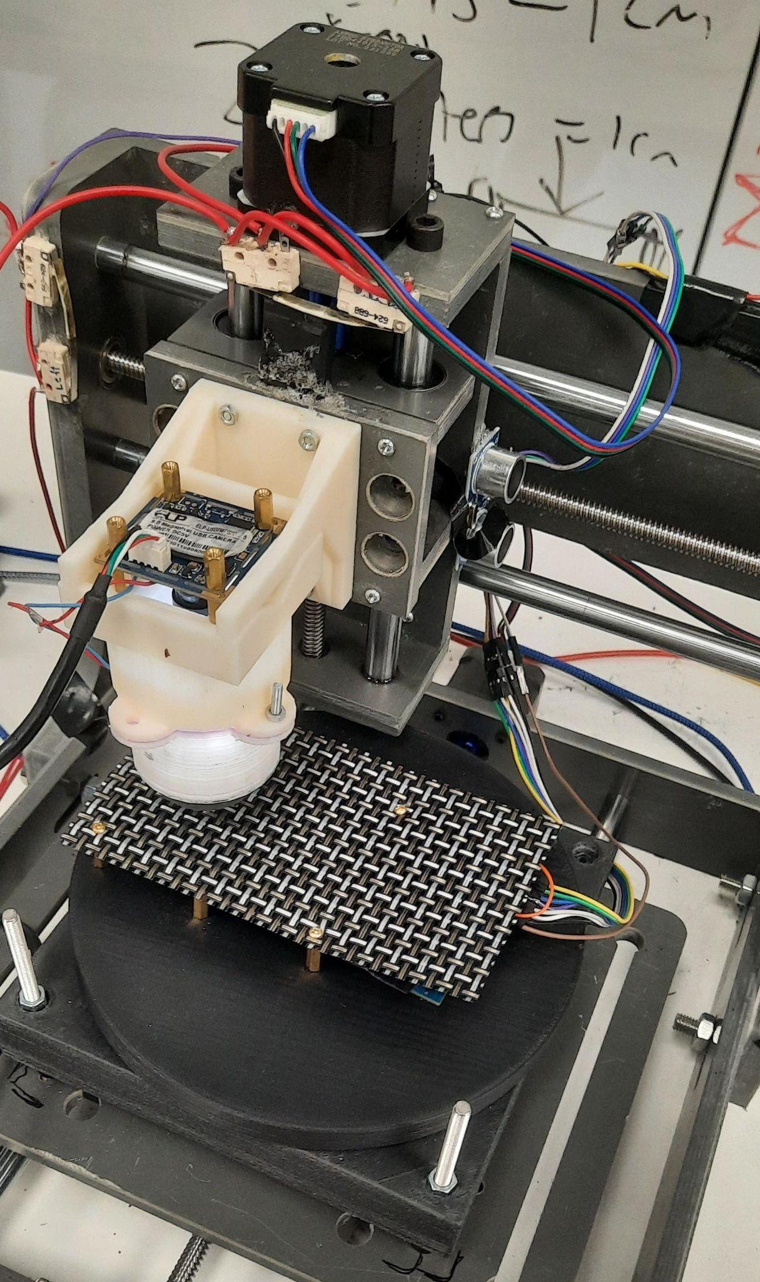
Example
Let’s say our device is gathering data and uploading it to a large powerful PC…
How important is memory?

Slide 28
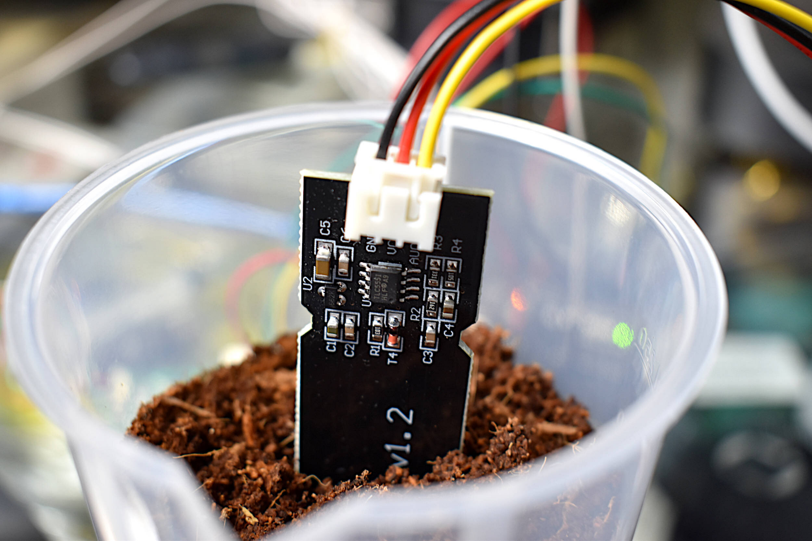
Example
Device monitoring on a small circuit board, uploading to an SD card
How much do we care about memory

Slide 29
Catching errors
It is good practice to catch errors of all sorts in your program
This can be done through assertions, but also through if statements
assert memory<10000, “Memory too big” # returns message#
if memory<1000: print(“Memory too big”)

Slide 30
Connecting to SD

Slide 31
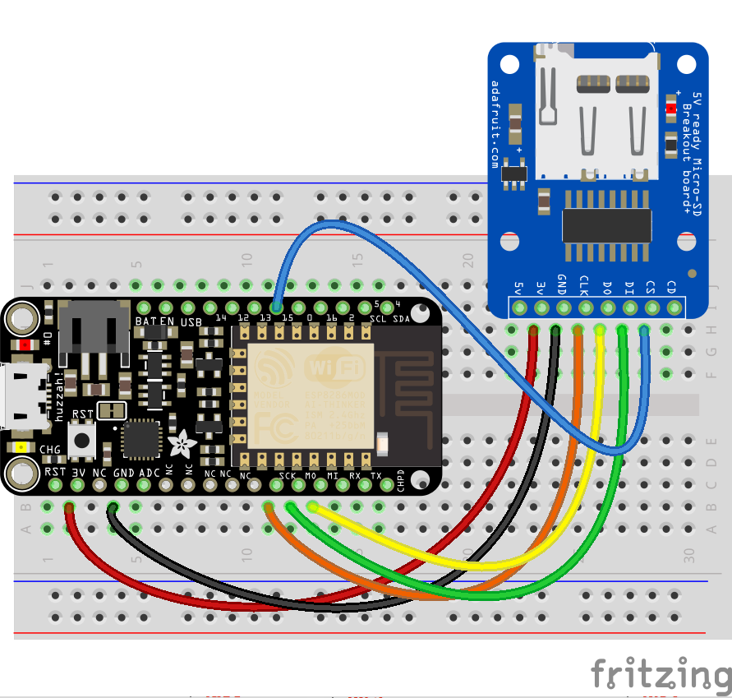
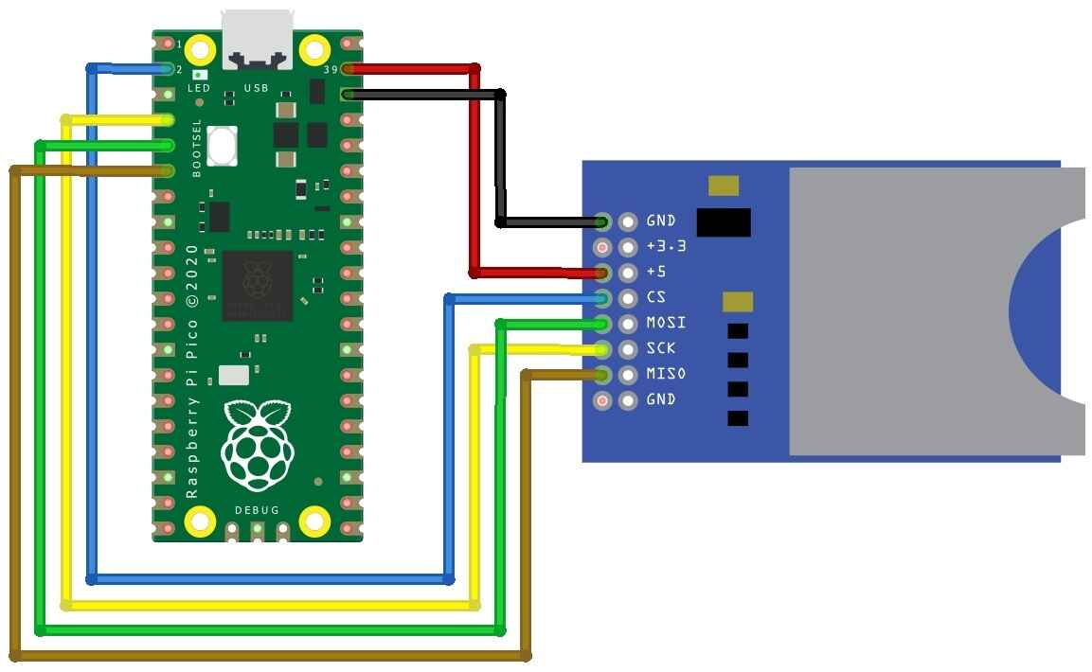
Wiring

Slide 32
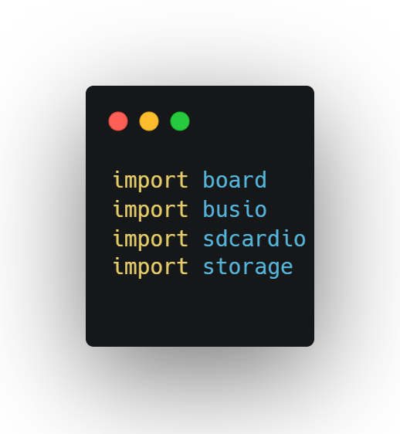
Libraries

Slide 33
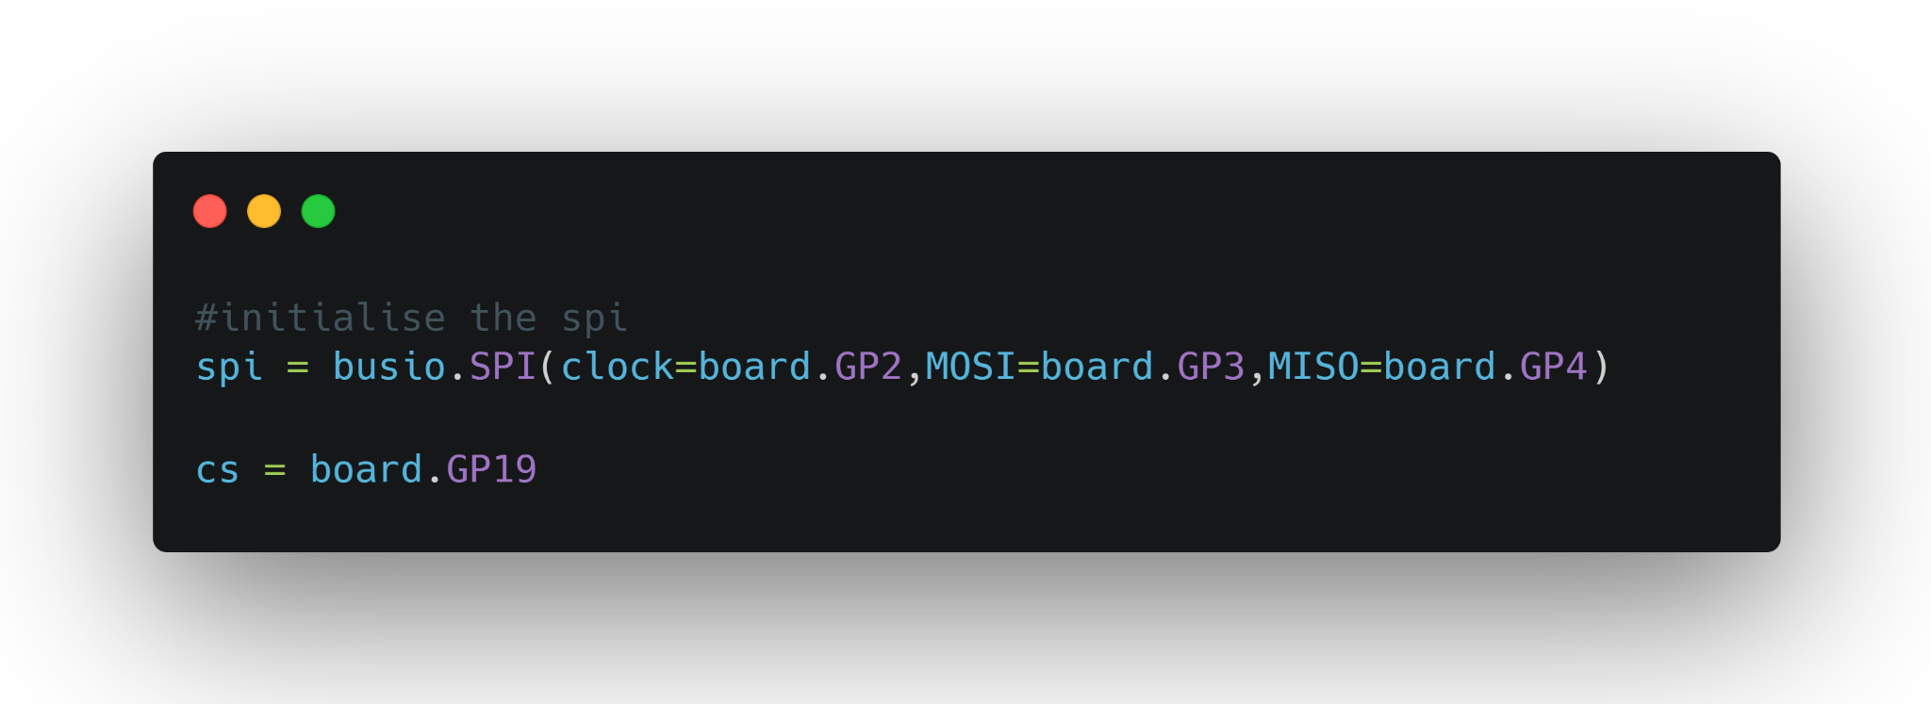
Setting up device
Not all pins are SPI compatible, see documentation!

Slide 34
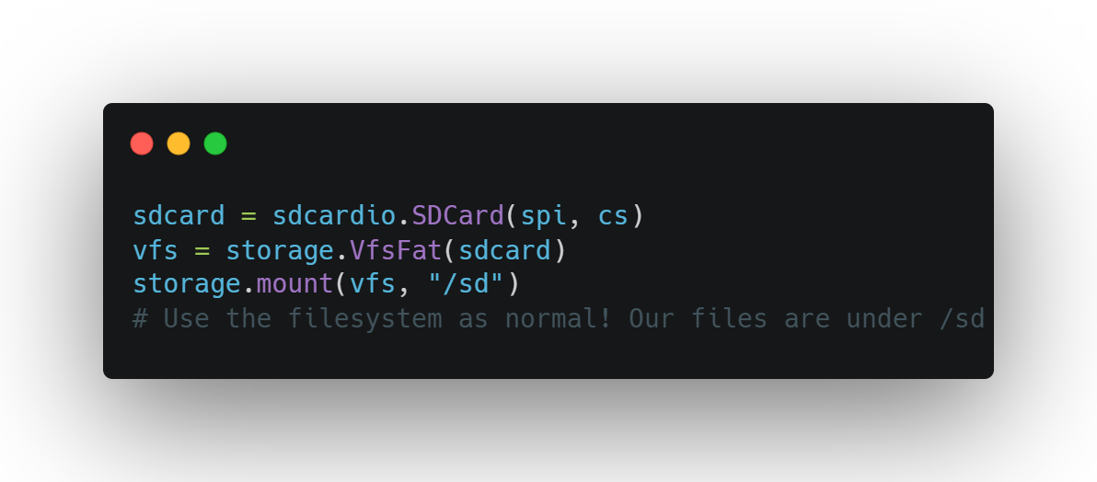
Connecting

Slide 35
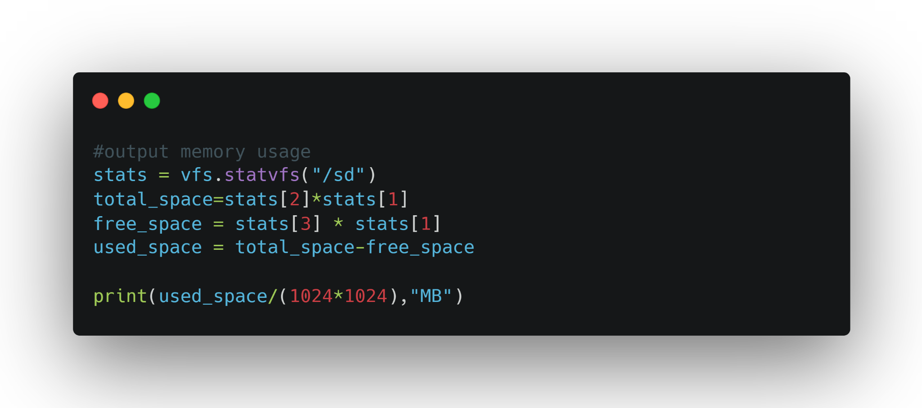
Checking memory
stats = os.statvfs("/sd")
total_space = stats[2] * stats[1]
free_space = stats[3] * stats[1]
used_space = total_space - free_space
print(used_space/ (1024 * 1024),”MB”)

Slide 36
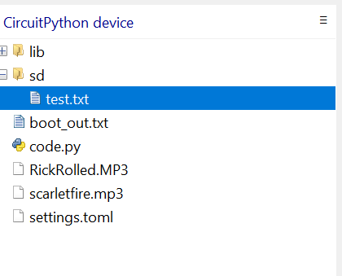
View file
You can take the SD out and put it in your PC
Or you can use Thonny’s inbuilt file directory
Thonny>View>Files

Slide 37
Potential issues
Wires not connected correctly
Invalid SPI pins
No “/sd” folder on Pico device

Slide 38
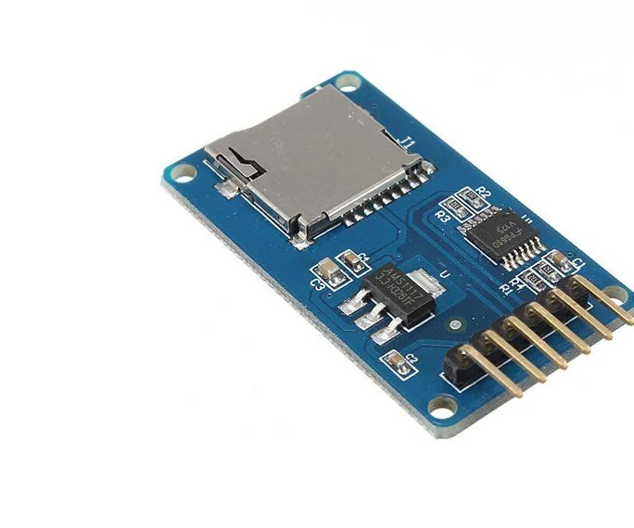
Something to be aware of
One of the sd card holders requires 3v and the other 5v.
For 5v connect to VBUS on the Pico

Slide 39
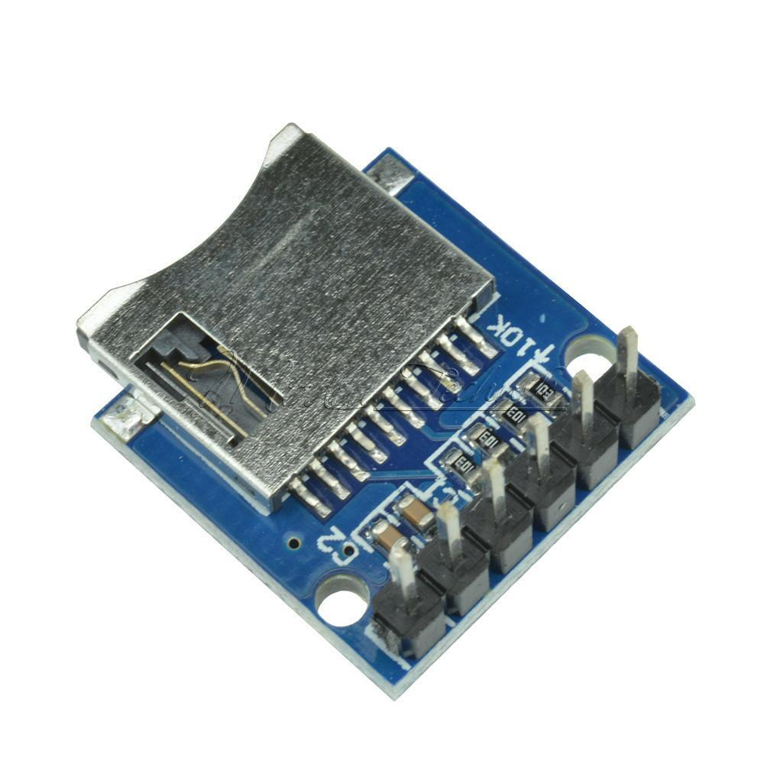
This one is fine
If you have this holder then you can use the 3v3out as usual

Slide 40
Writing to device

Slide 41
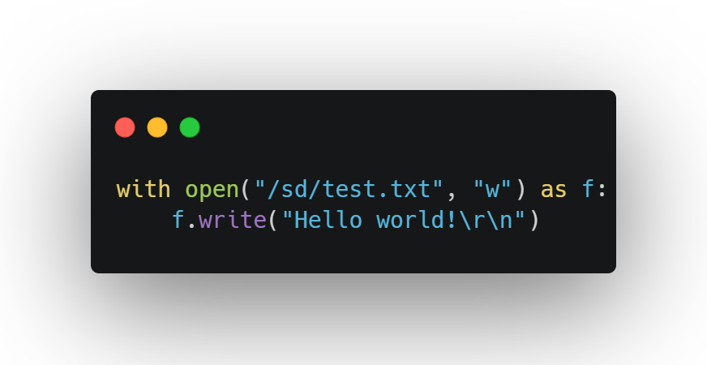
Write command

Slide 42
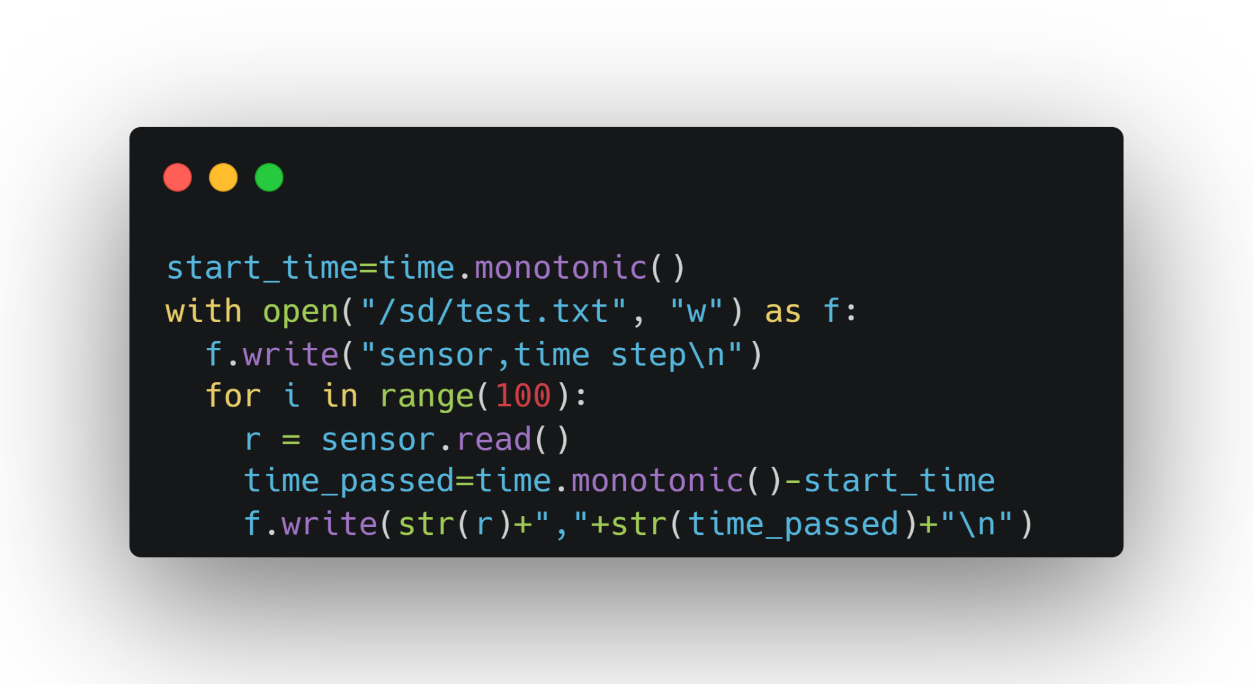
Integrating this with a sensor

Slide 43
Remember names of files
If you are making multiple readings around, makes sure you record this!
Usually if you had GPS sensors it makes it simpler, but if the data collection is a bit more manual you will may have to write it yourself.

Slide 44
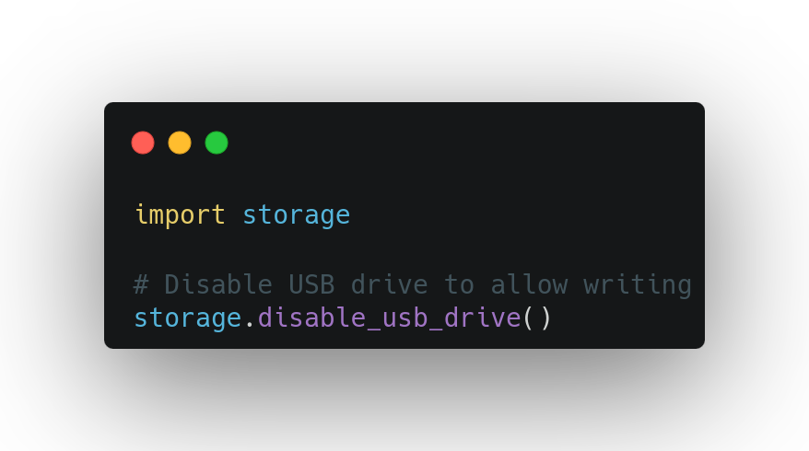
Using no SD card
This option has less storage but can be useful if budget/ wiring constraints are there.
This saves directly onto the Pico and can be accessed via the PC
TO do this you need to disable the USB drive via a file called boot.py

Slide 45
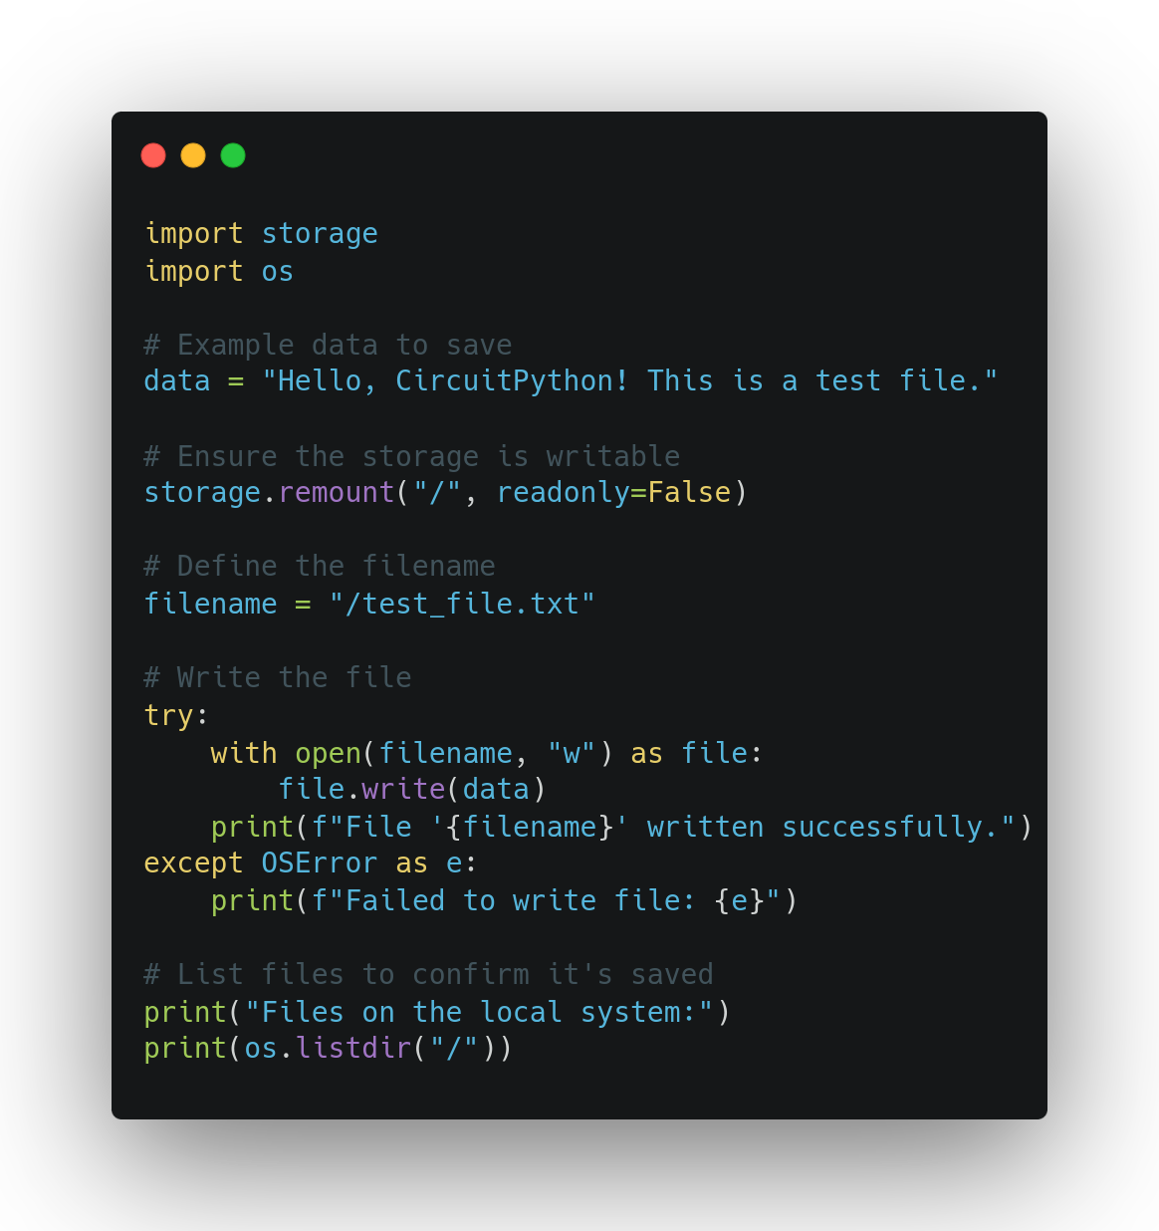
Then you can add whatever
Then you can mount “/” instead of “/sd”

Slide 46
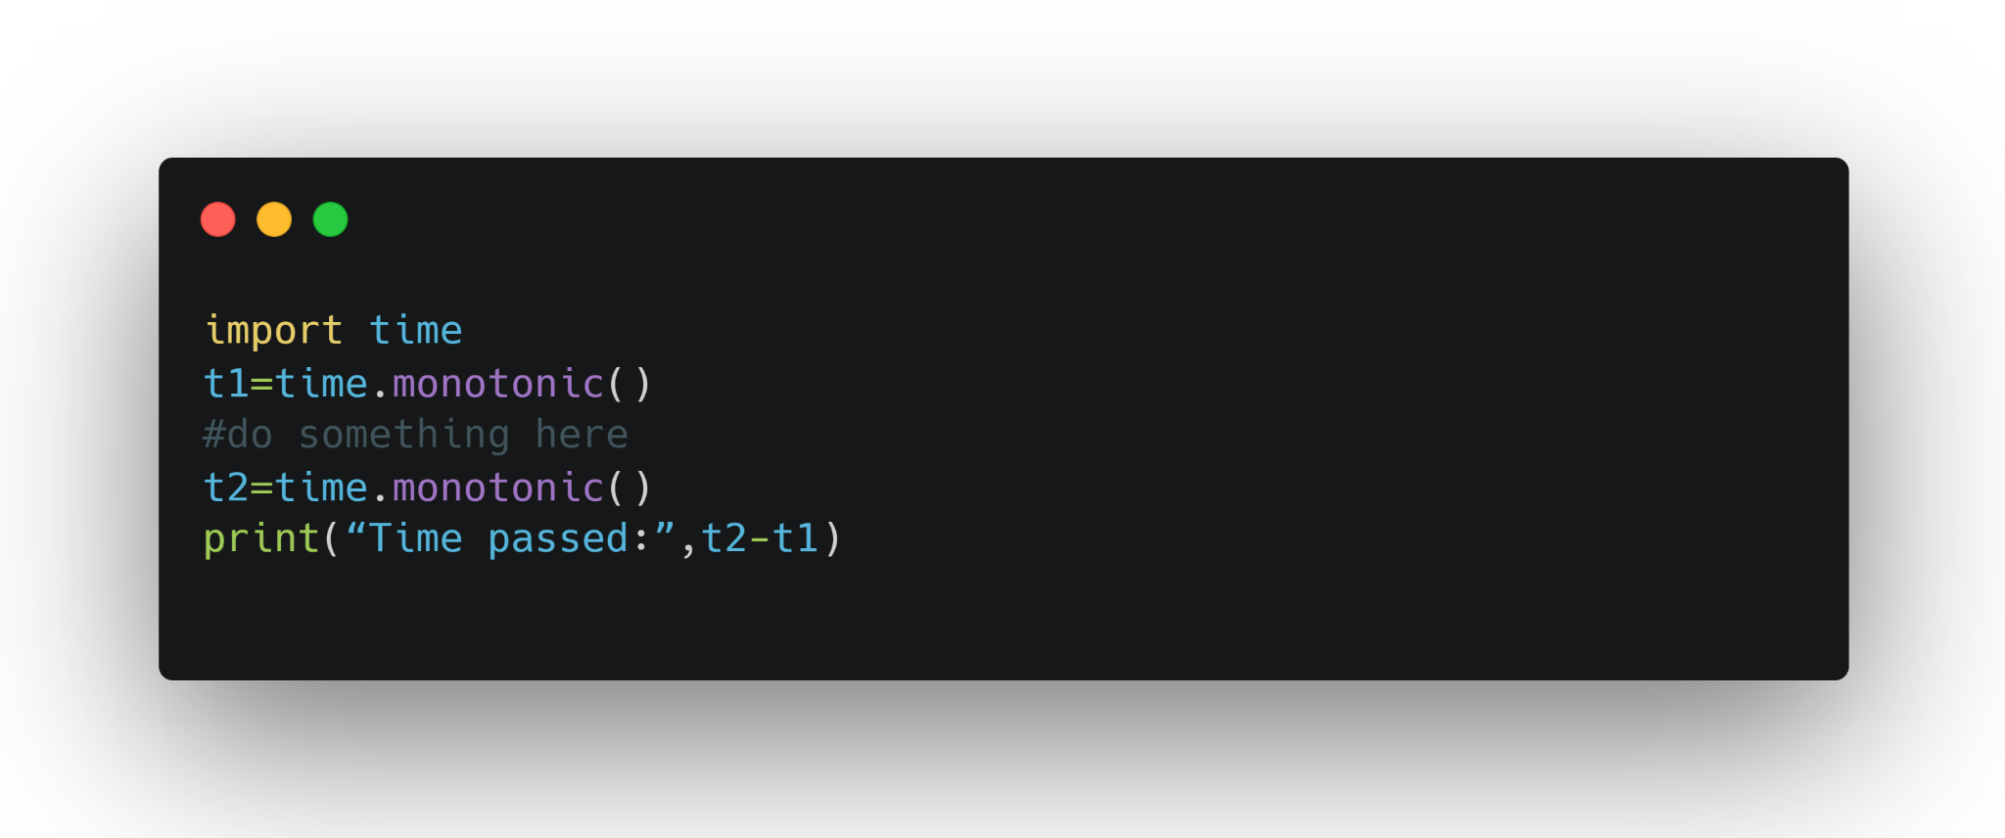
Time stamps
We collect time stamps so we can accurately measure the sample rate of our device, and match other sensor readings up with it.

Slide 47
Saving images

Slide 48
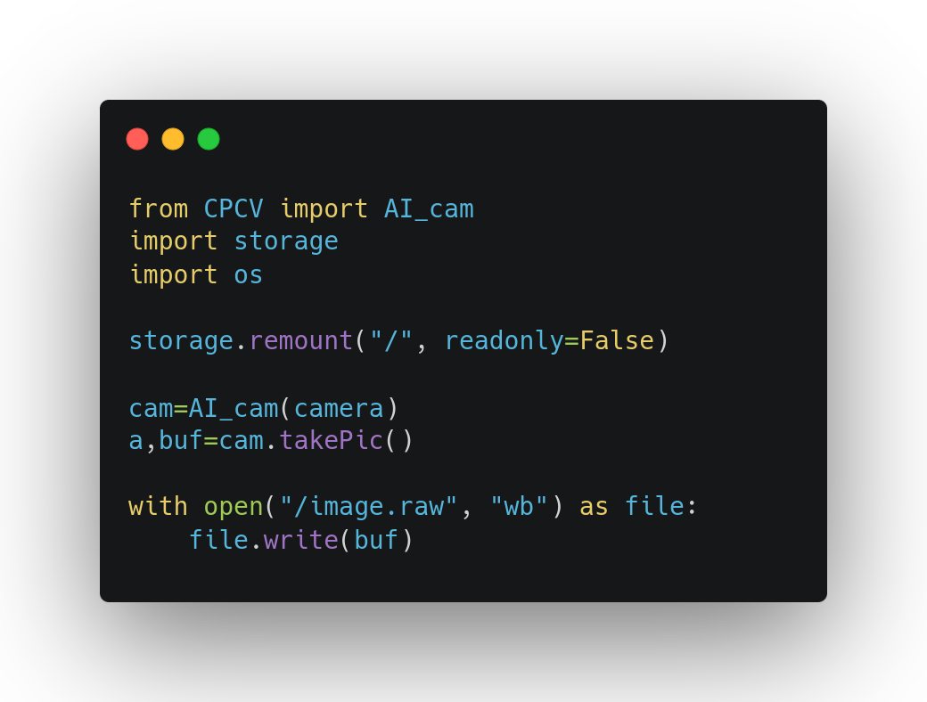
Saving the raw data
The lazy but computationally quick option is to save the raw data on the device, then convert it later
Find example codes: https://github.com/shepai/CircuitPython_CV

Slide 49
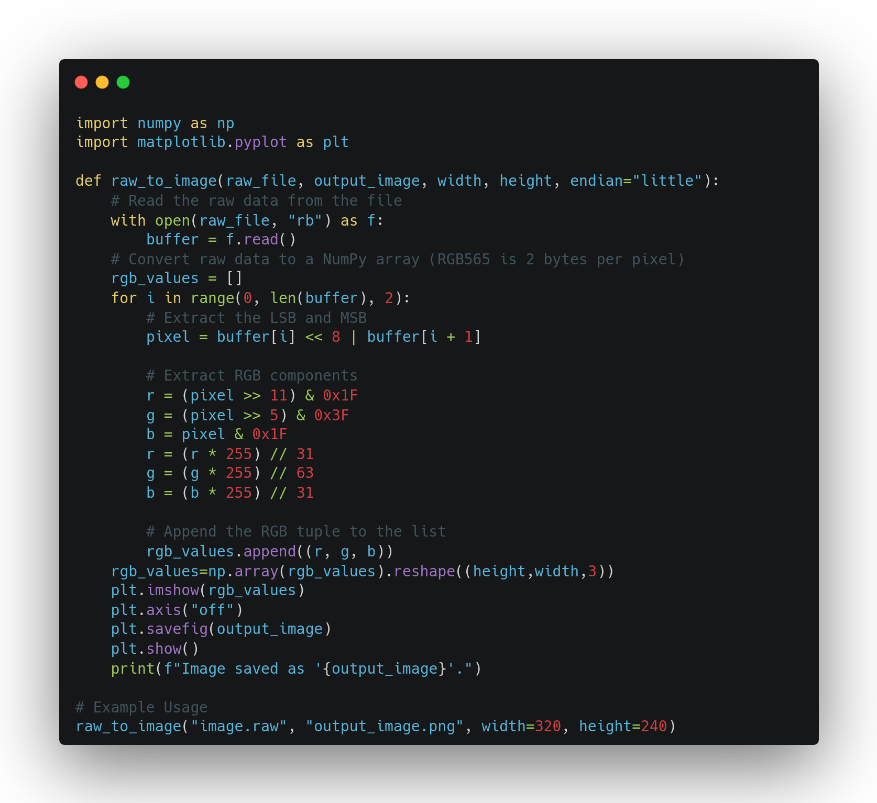
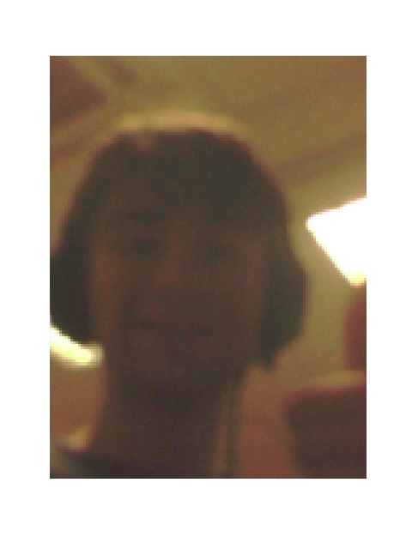
Converting this data
The raw data needs to be read and converted to an image file
Find example codes: https://github.com/shepai/CircuitPython_CV

Slide 50
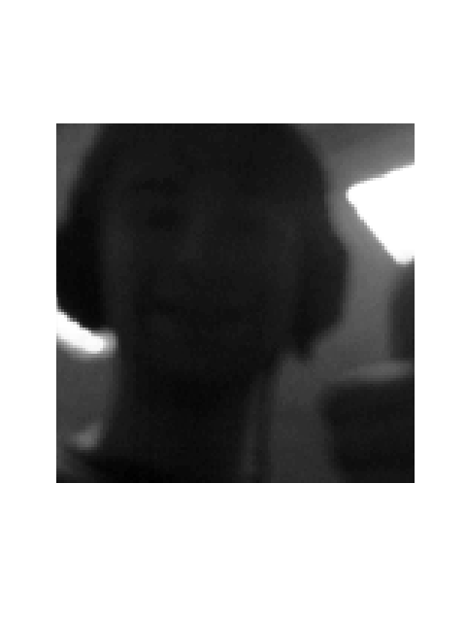
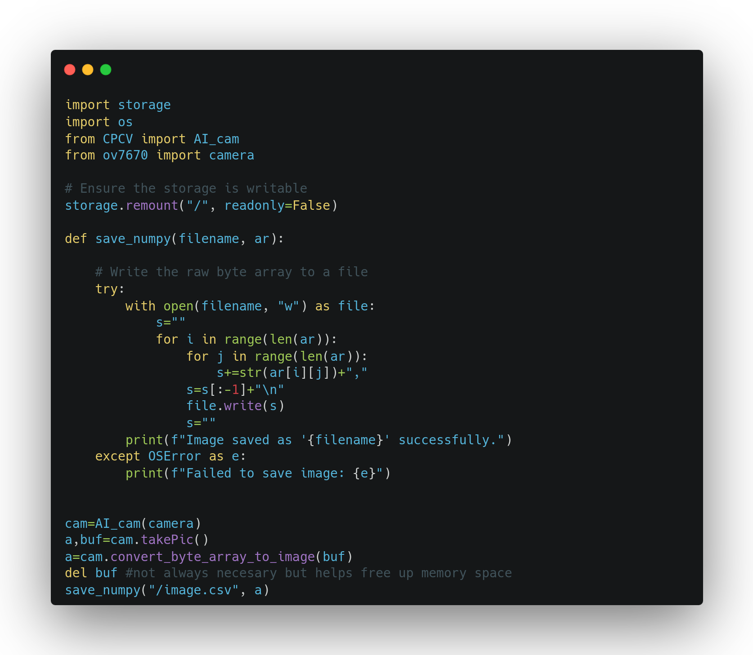
Converting on device
Much slower and uses more memory - not ideal for data collection… but more useful for applied ML
Find example codes: https://github.com/shepai/CircuitPython_CV

Slide 51
Gathering good data

Slide 52
Define objectives
Clearly outline the purpose of your data logging. What specific insights or outcomes are you aiming for?
Identify the key parameters you need to measure.

Slide 53
Choose appropriate sensors and tools
Select sensors or instruments that match the range, resolution, and accuracy required for your application.
Will your sensors actually influence the research question?
Using vibration sensors has nothing to do with soil moisture…. Or does it?

Slide 54
Calibrate sensors
Perform proper calibration before starting. Uncalibrated sensors can lead to systematic errors.
Regularly re-calibrate if you’re collecting data over long periods or in harsh conditions.
For example, how do you know what moisture levels correspond to in analogue reading? Set up a control experiment and regression model to interpret this data

Slide 55
Optimize Data Sampling
Determine the correct sampling rate:
High enough to capture relevant details
Low enough to avoid unnecessary data and save storage/memory.
Consider averaging multiple readings to reduce noise if precision is more critical than time resolution.
You can always experiment the other side how much data is needed

Slide 56
Validate the Data Pipeline
Test your data logging setup with trial runs to check for:
Missing data points.
Unexpected noise or artifacts.
Sensor or logger failures.
You can also log errors in your datalogging as well as the data
if len(sensor_reads)!=5:
logger.log(“error too many”+str(sensor_reads))

Slide 57
Minimize Noise and Interference
Shield your sensors and cables from electromagnetic interference (EMI).
Avoid environmental factors that can skew data (e.g., vibrations, temperature changes, or lighting variations).
Or on the other hand, make sure to gather data across lots of different environmental factors if your model is going to be robust

Slide 58
Synchronize Data
Ensure all sensors are time-synchronized if measuring multiple parameters.
Log timestamps for every data point or set of data.
We won’t be able to do this properly as we do not have time sensors… but its worth being aware of for temporal datasets

Slide 59
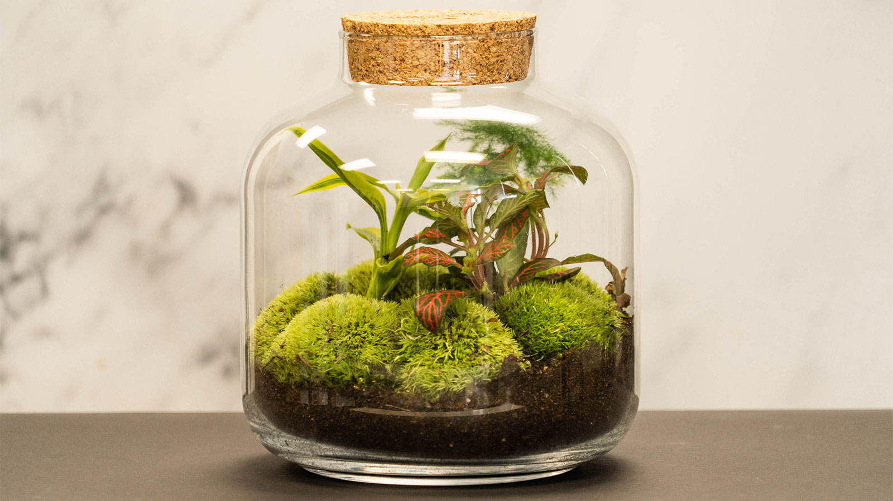
Durability
Will the device you have made be able to endure its location?
If it is outdoors will it need waterproofing?

Slide 60
Conclusions

Slide 61
Conclusions
The internet is full of datasets, and adding to the wealth of knowledge is good scientific practice
Data types and what storage formats are best for each
Memory constraints and how to deal with it
Connecting and logging on an SD card
What data we should gather

Slide 62
The labs

Slide 63
Creating data logging devices
We will be be applying the SD card saving and sensor reading we have covered over the past two days
Play around with the equipment individually

Slide 64
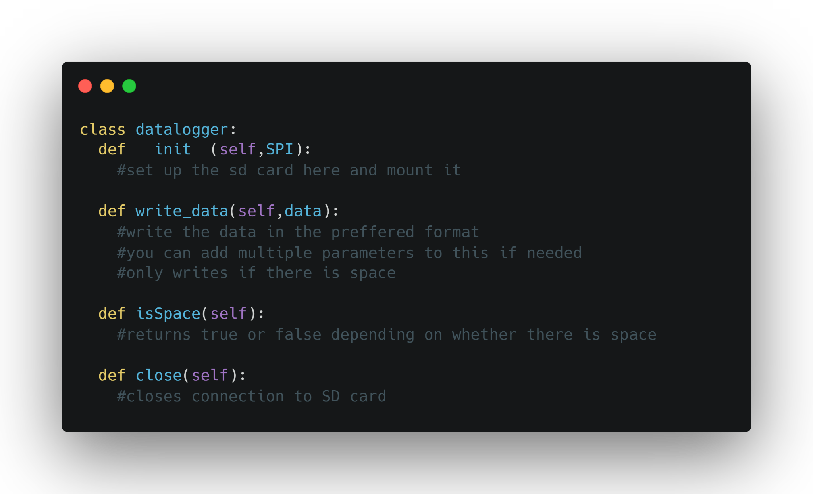
Tasks
Wire up an SD card and get it saving text files. Verify it is working by plugging the sd card into your computer
Add a memory check into the sd card
Make your code a class called datalogger
Extensions, add functions to your class that can
Write in json format
Write in csv format
Search for a time step in your data

Slide 65
Split off into your groups (ideally of size 3)
Discuss a project that you want to research, with the resources provided…
This could be
Looking at soil moisture from different areas
Making an image dataset of different plants (or something specific about those plants
Relationship of humidity, temperature and soil moisture
Try not all to do the same thing so we can use eachothers datasets

Slide 66
Task
Start putting together a device that can be used in the field to achieve the goals of your research project
Questions:
What sensors are relevant?
What format of data should be used?
Is this transportable to the field

